Slide 1

Optimizing Function Approximation with KAN
Leveraging KST for High-Dimensional Machine Learning
Maxwell Lam, Ben Moore, Matthew Robinson, Justin Xie

Slide 2
Overview
Overview of Kolmogorov Superposition Theorem (KST)
Recap of Multilayer Perceptron (MLP)
Kolmogorov-Arnold Networks: KST Applied
Challenges
6-Week Plan
Proposed Method & Experiment Setup
Results
Conclusion

Slide 3
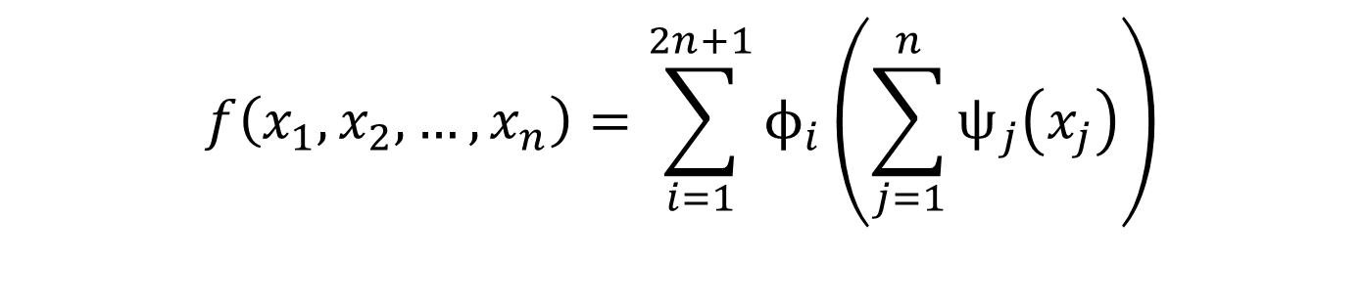
Kolmogorov Superposition Theorem (KST)
KST states that any multivariate continuous function can be exactly represented as a finite sum of compositions of continuous univariate functions.
Simplifies high-dimensional function approximation by reducing into univariate components.
$$f\left(x_{1},x_{2},…,x_{n}\right)=\sum_{i=1}^{2n+1}{ϕ_{i}\left(\sum_{j=1}^{n}{ψ_{j}\left(x_{j}\right)}\right)}$$

Slide 4
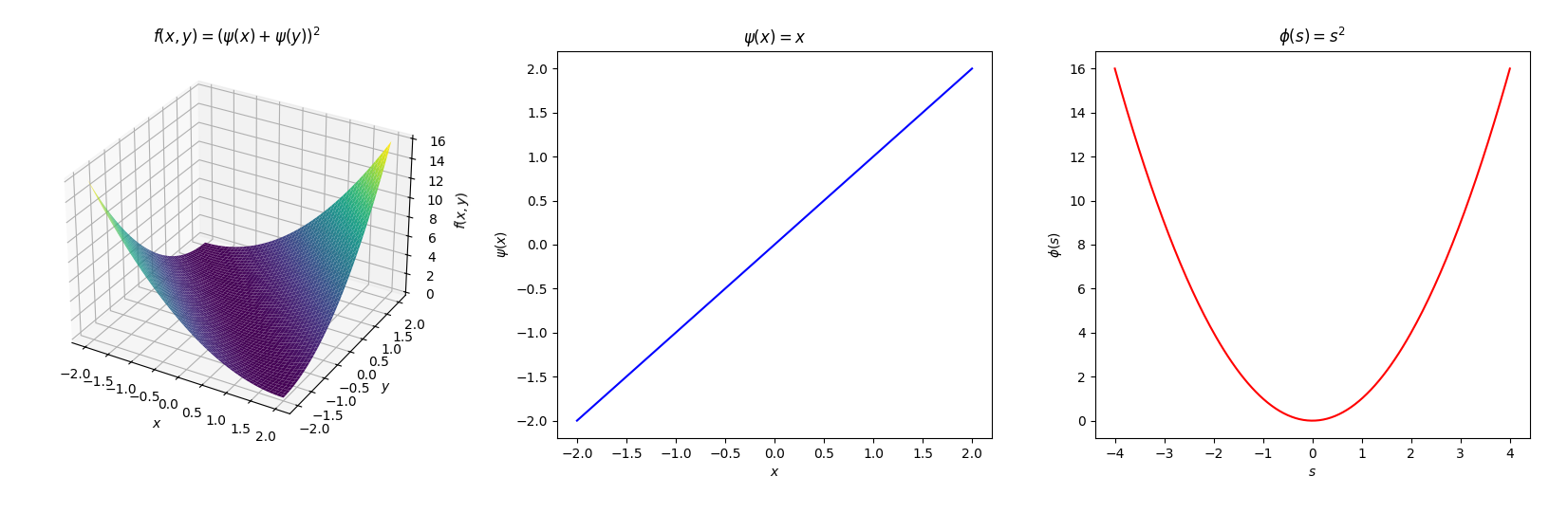
KST: Toy Example

Slide 5
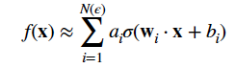
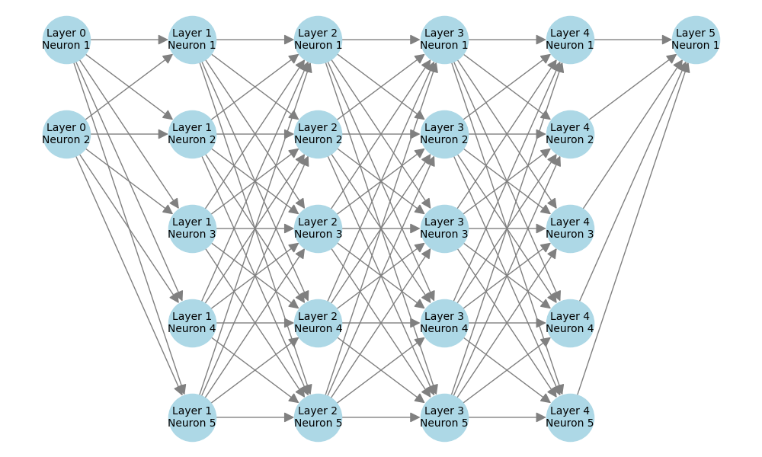
Multilayer Perceptron (MLP)
MLP formula:
Input layer
Hidden layer
Output layer
Apple sweet or not.
Apple size, firmness, or color.
Layer 4
Neuron 3
1
Tanh
-1
1
-1
Weight: 0.7
Activation Function
Tasty = f (size, firmness, color)

Slide 6
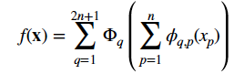
Kolmogorov Superposition Theorem (KST)
KST formula:
Input Layer
Outer Function
Inner Function
Hidden Layer
Composition of univariate functions
s
ϕ₁₁
ϕ₁₂
ϕ₁₃
size
Output Layer
T
ϕ₂₁
ϕ₂₂
ϕ₂₃
firmness
c
ϕ₃₁
ϕ₃₂
ϕ₃₃
color
Φ₁₁ (size)
Φ₁₂(firmness)
+
Φ₁₃ (color)
+
Φ₂₁ (size)
Φ₂₂ (firmness)
+
Φ₂₃ (color)
+
Φ₃₁ (size)
Φ₃₂ (firmness)
Φ₃₃ (color)
Tasty = f₁ (ϕ_{s1} (size) + ϕ_{f1} (firmness) + ϕ_{c1} (color) )
+ f₂ (ϕ_{s2} (size) + ϕ_{f2} (firmness) + ϕ_{c2} (color) )
+ f_{n}…. n
+
+
Input features

Slide 7
KST: Challenges
Hard to apply directly in high-dimensional machine learning tasks designed for traditional approaches.
No explicit algorithm for determining these univariate functions.
Computational complexity grows exponentially with dimensionality.

Slide 8
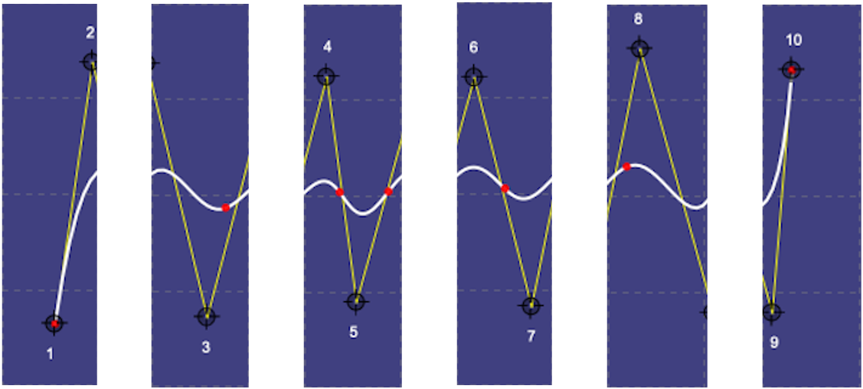
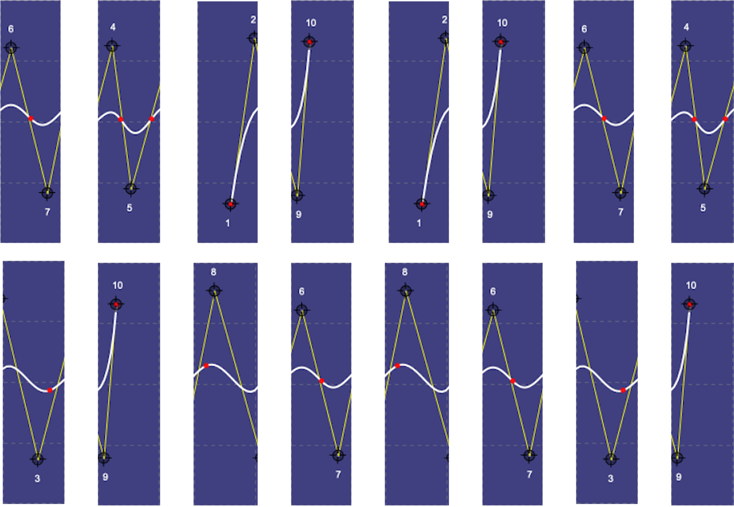
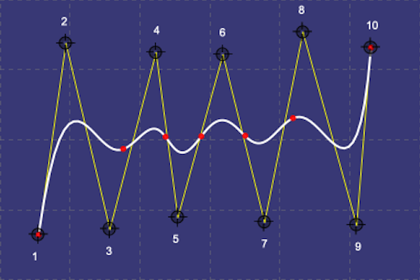
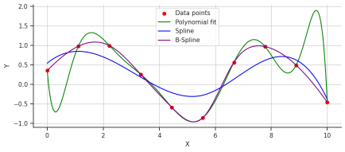
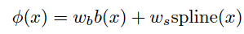
KST: Solution
Polynomial fit
1st
2nd
3rd
Function fitting figure from: https://daniel-bethell.co.uk/posts/kan/
https://demonstrations.wolfram.com/BSplineCurveWithKnots/

Slide 9
6-Week Implementation Plan
Week | Task
Week 1 | Understand the Kolmogorov Superposition Theorem (KST) and its implications for function approximation.
Week 2 | Develop a specific strategy for KST implementation; plan for coding and datasets.
Week 3 | Begin coding KAN, validating the theoretical approach with simple examples.
Week 4 | Improve the algorithm and test it on real-world problems.
Week 5 | Integrate KST into neural network architectures and perform preliminary testing.
Week 6 | Finalize the project: wrap up code, run comprehensive tests, and document the results.
Notes:
Slide Title: Weekly Milestones BreakdownWeek 1: • Objective: Gain a deep understanding of the Kolmogorov Superposition Theorem and how it applies to neural networks. • Key Task: Study related literature, explore prior applications of KST, and identify key challenges for implementation.Week 2: • Objective: Develop a strategy for implementing KST in machine learning contexts. • Key Task: Set up coding infrastructure and plan datasets for KAN testing. Outline the architecture for applying KST-based networks.Week 3: • Objective: Start implementing KAN and validate theoretical models with simpler, low-dimensional data. • Key Task: Code the initial KAN model, test it with basic examples to ensure it approximates multivariate functions effectively.Week 4: • Objective: Improve the KAN algorithm, ensuring it can handle more complex and high-dimensional data. • Key Task: Introduce optimizations (e.g., Chebyshev polynomials, splines) to reduce computational complexity. Test with more challenging datasets.Week 5: • Objective: Integrate KAN into existing neural network architectures for real-world applications. • Key Task: Combine KAN with a neural network framework and perform integration tests. Identify performance metrics and assess model accuracy and efficiency.Week 6: • Objective: Finalize the KAN project, focusing on producing a working implementation and reporting results. • Key Task: Fine-tune the model, conduct comprehensive testing, and document findings. Prepare final codebase and results for review and submission.

Slide 10
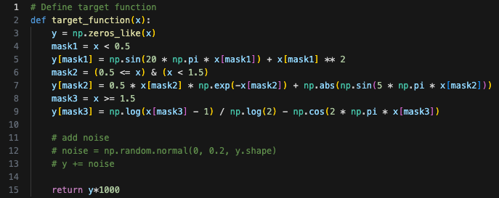
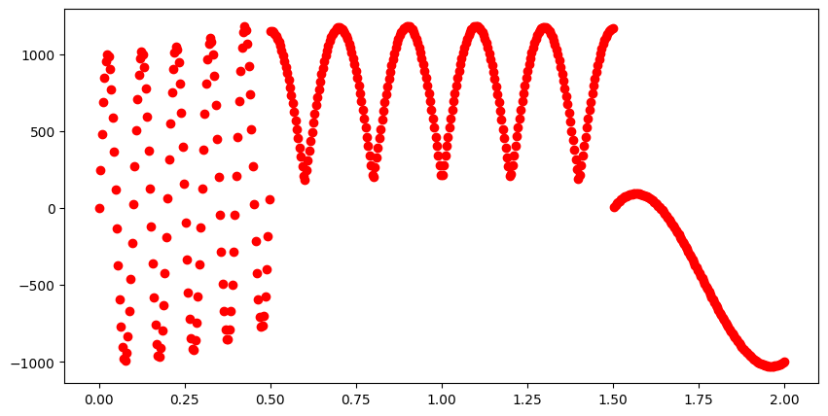
Experiment Setup
MLP
Scale up to test Neural Networks under Extreme condition
KST + Spline
Logarithmic patterns
KST + Polynomial
Exponential growth
Sine waves

Slide 11
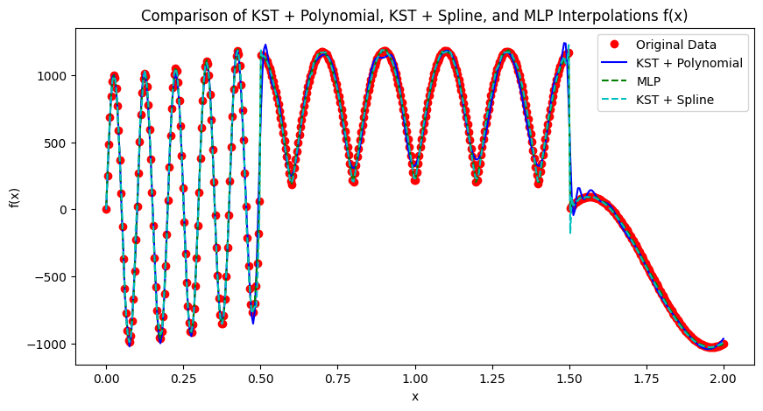
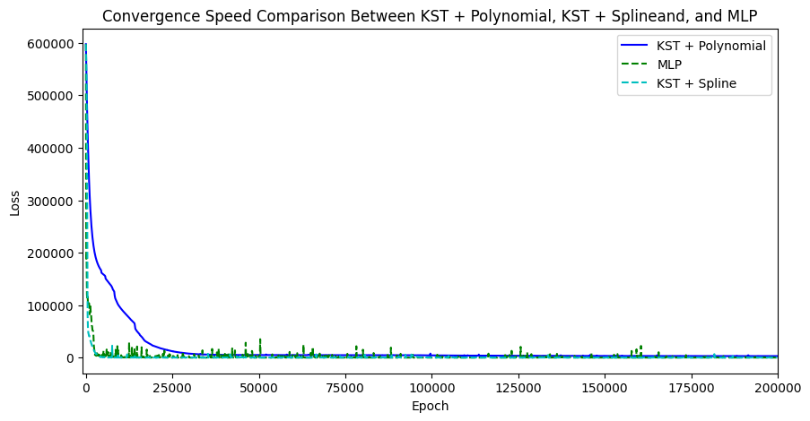
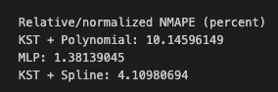
Neural Network Configurations
NMAPE: show errors percentage across datasets
Neural Networks | MLP | KST + Spline | KST + Polynomial
Network Structure | [1, 128, 128, 128, 1] | [1, 8, 1] | [1, 8, 1]
Epochs for training | 200k | 200k | 200k
Learning rate | 0.01 | 0.01 | 0.01
Optimizer | Adam | Adam | Adam
Code of KST is adapted from:
https://github.com/SynodicMonth/ChebyKAN/tree/5f7efdd18e749bcc99481bd87dc90bdeafb920d8
and https://kindxiaoming.github.io/pykan/examples.html

Slide 12
KST: optimization
Add LBFGS as additional optimizer
Adam – 10000 epochs
LBFGS - 500 iterations
- 100 epochs
Reduced total epochs from 200k to (10k + 50k) .
$$Number of Iteration Reduce= \frac{200,000 −60,000}{200,000} ∗100=70\%$$
Adam : Adaptive Moment Estimation
LBFGS: Limited-memory Broyden–Fletcher–Goldfarb–Shanno

Slide 13
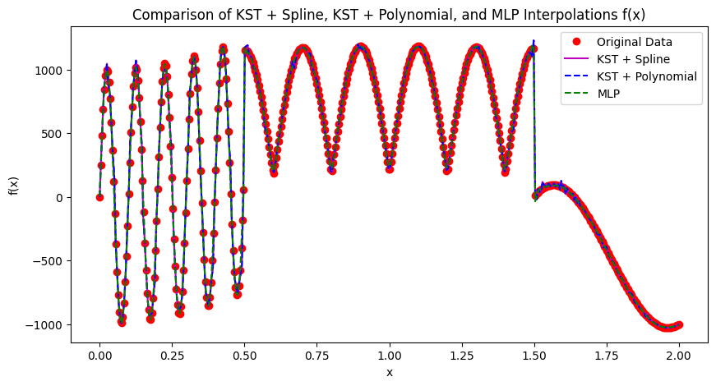
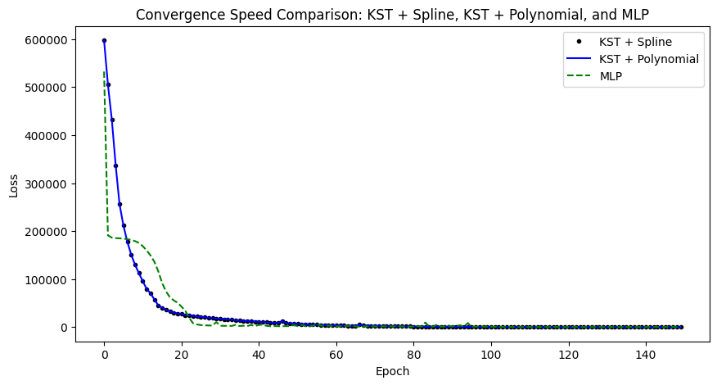
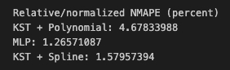
Neural Network Configurations
NMAPE: show errors percentage across datasets
Neural Networks | MLP | KST + Spline | KST + Polynomial
Network Structure | [1, 128, 128, 1] | [1, 20, 20, 1] | [1, 20, 20, 1]
Epochs for training | 10k + 50k | 10k + 50k | 10k + 50k
Learning rate | 0.01 | 0.01 | 0.01
Optimizer | Adam + LBFGS | Adam+ LBFGS | Adam+ LBFGS
Before
After
KST + Polynomial$Improvement= \frac{10.14596149 −4.67833988}{10.14596149}∗100=53.89\%$
KST + Spline$Improvement= \frac{4. 10980694−1.57957394}{4.10980694}∗100=61.54\%$
Code of KST is adapted from:
https://github.com/SynodicMonth/ChebyKAN/tree/5f7efdd18e749bcc99481bd87dc90bdeafb920d8
and https://kindxiaoming.github.io/pykan/examples.html

Slide 14
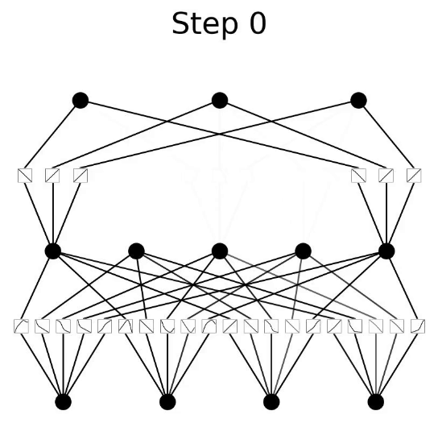
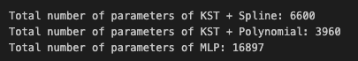
Total Number of Parameters
MLP
KST + Spline / KST + Polynomial
[1, 20, 20, 1]
[1, 128, 128, 1]
 | 1*128 | 128*128 | 128*1
weight | 128 | 16384 | 128
bias | 128 | 128 | 1
total | 256 | 16512 | 129
+
+
+
=
=
=
Total number of parameters for MLP:
256 + 16512 + 129 = 16897
KST image: https://github.com/team-daniel/KAN

Slide 15
Results – Total Simulation Time
 | Adam Simulation Time (second) | LBFGS Simulation Time (second) | Total Simulation Time
MLP | 27.7125 | 35.1537 | 62.8662
KST + Polynomial | 54.5825 | 99.7822 | 154.3647
KST + Spline | 146.2388 | 135.8480 | 282.0868
$$Time Improvement= \frac{282.0868 −154.3647}{282.0868}∗100=45.27\%$$

Slide 16
Conclusion
The use of Adam in conjunction with L-BFGS significantly shortens the learning process for KST and improves model accuracy. This combination leverages the fast convergence of Adam in early stages and the fine-tuning capability of L-BFGS, making training more efficient and yielding better results
Using KST with a polynomial fit reduces computational time by approximately 45% compared to using spline fitting, while achieving comparable accuracy.
KST can reach accuracy levels similar to traditional MLP, but it still requires a longer training period.

Slide 17
Possible Future Work
Modify KST to run on GPU (can run on GPU, but slower than CPU)
Optimize KST model by using hyperparameter tuning tools
Embedding KST into Physics-Informed Neural Networks (PINNs)

Slide 18
References
Bethell, D. Demystifying Kolmogorov-Arnold Networks: A Beginner-Friendly Guide with Code. Available at: https://daniel-bethell.co.uk/posts/kan/​
Wolfram Demonstrations Project. B-Spline Curve with Knots. Available at: https://demonstrations.wolfram.com/BSplineCurveWithKnots/
SynodicMonth, "ChebyKAN," GitHub repository, Available: https://github.com/SynodicMonth/ChebyKAN/tree/5f7efdd18e749bcc99481bd87dc90bdeafb920d8. [Accessed: Nov. 17, 2024].
Xiaoming, "PyKAN Examples," Available: https://kindxiaoming.github.io/pykan/examples.html. [Accessed: Nov. 17, 2024].

Slide 19
Q & A

